Slide 1


Machine Intelligence
Computational Learning
Dr. Arti Arya
Department of Computer Science
artiarya@pes.edu
+080-66186629 Extn 6629

Slide 2
MACHINE INTELLIGENCE
PAC Learning
Dr. Arti Arya
Department of Computer Science and Engineering

Slide 3

MACHINE INTELLIGENCE
Computational Learning Theory
I always wondered about the following queries:
Is a ML model always capable of learning?
How many instances would be sufficient for training a ML model?
Is it possible under any circumstances that learning process become impossible?
Under what conditions successful learning is possible or impossible?

Slide 4
MACHINE INTELLIGENCE
Computational Learning Theory
CoLT is a subset or subdomain of ML that studies the complexity of the learning algorithms.
There are many subfields of study, although perhaps 2 of the most widely discussed areas of study from Computational Learning Theory(CoLT) are:
1. PAC Learning
2. VC Dimension

Slide 5
MACHINE INTELLIGENCE
Computational Learning Theory
Computational Learning Theory or CLT:
Provides a theoretical analysis of learning
Shows when a learning algorithm can be expected to succeed
Shows when learning may be impossible

Slide 6
MACHINE INTELLIGENCE
Theoretical Characterization of Learning Problems
Under what conditions is successful learning possible and impossible?
Under what conditions is a particular learning algorithm assured of learning successfully?

Slide 7
MACHINE INTELLIGENCE
Theoretical Questions of Interest
Is it possible to identify classes of learning problems that are inherently difficult or easy, independent of the learning algorithm?
Can one characterize the number of training examples necessary or sufficient to assure successful learning?
How is the number of examples affected
If observing a random sample of training data?
If the learner is allowed to pose queries to the trainer?
Can one characterize the number of mistakes that a learner will make before learning the target function?
Can one characterize the inherent computational complexity of a class of learning algorithms?

Slide 8
MACHINE INTELLIGENCE
Goal is to answer questions like:
Sample Complexity
How many training examples do we need to converge to a successful hypothesis with a high probability?
Computational Complexity
How much computational effort is needed to converge to a successful hypothesis with a high probability?
Mistake Bound
How many training examples will the learner misclassify before converging to a successful hypothesis?

Slide 9
MACHINE INTELLIGENCE
The Problem Setting for PAC
Given:
set of instances X − set of hypotheses H
set of possible target concepts C, c:X→{0,1}
training instances generated by a fixed, unknown probability distribution D over X
Learner L observes a sequence of training examples
<x, c(x)>, for some target concept c ∈ C
Learner must output a hypothesis h estimating c
h is evaluated by its performance on subsequent instances drawn according to D
To determine
A hypothesis h ∈ H such that h(x)=c(x), ∀ x ∈ D
A hypothesis h ∈ H such that h(x)=c(x), ∀ x ∈ X
True Error
Training Error

Slide 10
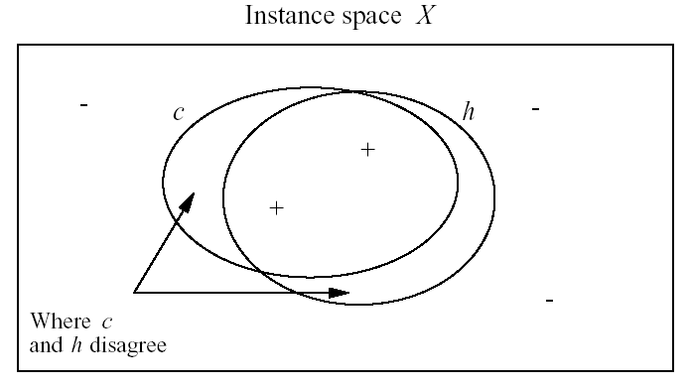

MACHINE INTELLIGENCE
True Error of a Hypothesis
h is the “best hypothesis” in H for D.
c is the target label which is to be learnt from H
Definition: The true error (denoted error_{D}(h)) of hypothesis h with respect to target concept c and distribution D is the probability that h will misclassify an instance drawn at random according to D.

Slide 11
MACHINE INTELLIGENCE
Considerations
Two Considerations:
1. We don’t want a hypothesis or approximation with zero error. There might be some error as long as it is small (bounded by a constant ε).
2. We don’t need to always produce a good hypothesis for every sample of examples (the probability of failure will be bounded by a constant δ).

Slide 12
MACHINE INTELLIGENCE
The PAC Learning Framework
PAC( probably approximate correct) Learnability:
A class of concepts C
can be called as PAC learnable by a
Learner L using H if (∀ c ∈ C, distributions D over X),
for some 0 ≤ δ , ε ≤ ½
L will output the hypothesis h ∈ H
(but only with a probability at least (1- δ))
such that error_{D}(h) ≤ ε,
in polynomial time in 1/ ε, 1/ δ,n and size (c)
P [Pr(c(x) ≠h(x)] ≤ ε] ≥ 1- δ

Slide 13
MACHINE INTELLIGENCE
Two expectations from L
Two expectations from L
L must o/p hypothesis h with high probability (1- δ) but with low error ε .
This learning of hypothesis should happen in efficient time which grows polynomial with 1/ ε, 1/ δ,n and size (c)

Slide 14
MACHINE INTELLIGENCE
PAC Learnability
If L requires some minimum processing time per training example, then for C to be PAC-learnable by L, L must learn from a polynomial number of training examples.
Given the tr. examples, we need to find the hypo. which agrees with tr. examples.( ie consistent hypo)
Is there a way to be certain about how the learner/ learning algorithm generalizes?
If we have to guarantee that hypo is the correct hypo then it must label all the examples correctly.
For that we have to check all the examples.
(This is called as no free lunch)

Slide 15
MACHINE INTELLIGENCE
Sample Complexity
Sample Complexity:
How many training examples do we need to converge to a successful hypothesis with a high probability?
Question is “Can we put a bound on Sample Complexity( for a class of consistent learners)?
Ans: YES
Consistent Learner:
is one that gives a hypothesis h that fits training examples perfectly, whenever possible.

Slide 16
MACHINE INTELLIGENCE
Sample Complexity
Let’s review VS
VS_{H,D}={h ∈H| ∀(x,c(x)) ∈D), h(x)=c(x)}
Consistent learner h ∈ VS_{H,D}(irrespective of X, H or X)
Let me add more to it,
I want to put a bound on the “no. of examples(m)” which are an input to Learner L to learn consistent hypothesis.
Let me put a bound on “no. of examples”
assures that VS_{H,D} doesn’t ⊂ any inconsistent hypothesis.
outputs
This means, let me put a bound on ‘m’ that

Slide 17
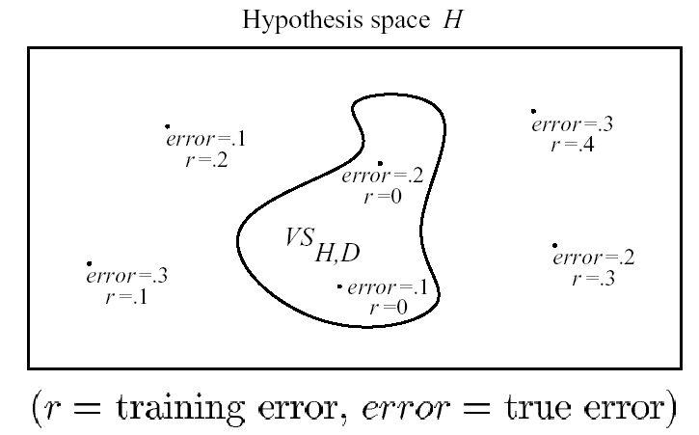
MACHINE INTELLIGENCE
Exhausting VS
Definition:
H, c, D, set of training examples D have their usual meaning. VS_{H,D} is said to be ε-exhausted wrt c if
∀ h ∈ VS_{H,D} has error < ε with respect to c and D, ie
(∀ h ∈ VS_{H,D})error_{D}(h)< ε

Slide 18
MACHINE INTELLIGENCE
How many examples will ε-exhaust the VS?
We can now talk about bounding the “ Probability that the VS_{H,D} will be ε-exhausted after a given training examples”.
So we can describe ε-exhausting VS
Theorem [Haussler, 1988] :
If the hypothesis space H is finite, and D is a sequence of m ≥ 1 independent random examples of some target concept c, then for some 0 ≤ ε ≤ 1, the
P(VS_{H,D} is not ε-exhausted) ≤ |H|e^{-εm}

Slide 19
MACHINE INTELLIGENCE
Proof:
Let h₁, h₂, ……..h_{k} ∈ H
s.t. error_{D}(h_{i})> ε.
We fail to ε-exhaust VS_{H,D}
iff
At least one of k hypo. say h_{t} happens to be consistent with all m training examples.
P(error_{D}(h_{t})> ε)≤(1- ε)
∴ the prob. that h_{t} will be consistent with m independent randomly drawn examples is
P(error_{D}(h_{t})> ε)≤(1- ε)^{m}

Slide 20
MACHINE INTELLIGENCE
As there are k such hypothesis,
∴ the prob. that at least one of these k hypothesis will be consistent with all m training examples is at most = k (1- ε)^{m}
As, k ≤ |H|, ∴ k (1- ε)^{m} ≤ |H| (1- ε)^{m} -------------(1)
Generalizing, if 0 ≤ ε ≤1, then (1- ε) ≤ e^{-ε}
∴ From (1), k (1- ε)^{m} ≤ |H| (1- ε)^{m} ≤ |H| e^{-εm}

Slide 21
MACHINE INTELLIGENCE
So, this is an UB on the prob. that the VS is ε-exhausted, based on m tr. examples.
Using above result, lets try to determine the # of tr. examples required to reduce this prob. of failure below a certain level δ.
|H| e^{-εm} ≤ δ
Solving for m,
ln |H|+(-εm ) ≤ ln(δ)
or (ln |H|-ln(δ))/ ε ≤ m
or (ln |H|+ln(1/δ))/ ε ≤ m

Slide 22
THANK YOU
Dr. Arti Arya
artiarya@pes.edu
+91 66186629 Extn 6629

